Slide 1
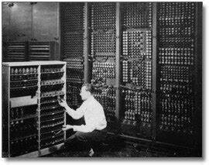
Evolution of Computing
Presented By Tayyba Aftab
To Miss Amna

Slide 2

Earliest Calculating Devics
The earliest known calculating device is the abacus, which dates back to at least 1100 BCE
Abacus beads can be readily manipulated to perform the common arithmetical operations—addition, subtraction, multiplication, and division

Slide 3
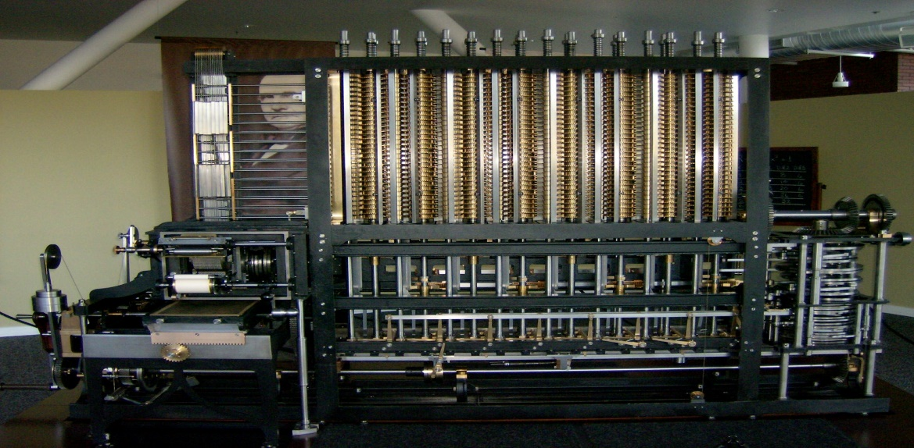
First Computer
In the 19th century, Charles Babbage, a British polymath, is credited with conceiving the first automatic digital computer.
Charles Babbage is widely recognized as the father of the computer

Slide 4
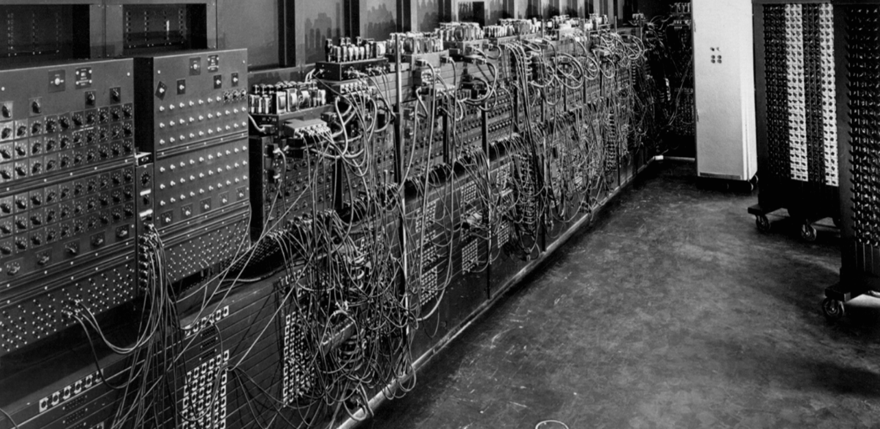
ENIAC (1946)
The Electronic Numerical Integrator and Computer (ENIAC) was the first electronic general-purpose computer.
It occupied an entire room and was used primarily for numerical calculations

Slide 5
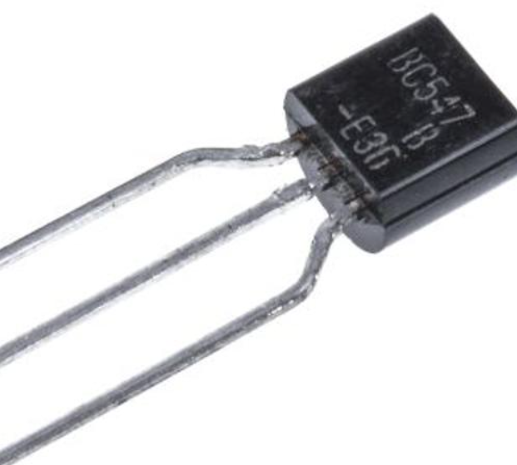
Transistors (1950s)
The development of transistors in the 1950s replaced vacuum tubes, leading to smaller, faster, and more reliable computers.
This marked a major advancement in computing technology.

Slide 6
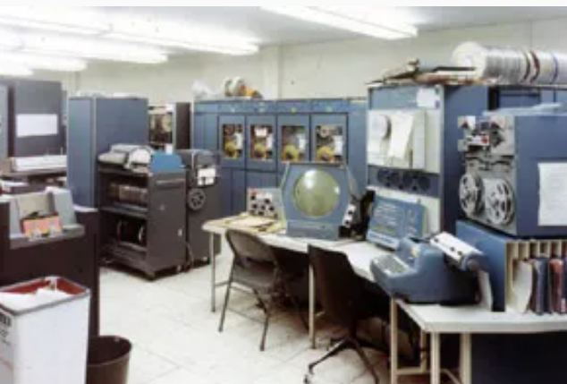
Mainframes and Minicomputers (196)
Mainframes were powerful machines used by large organizations for critical applications.
Minicomputers were smaller and more affordable, suitable for a wider range of tasks.

Slide 7
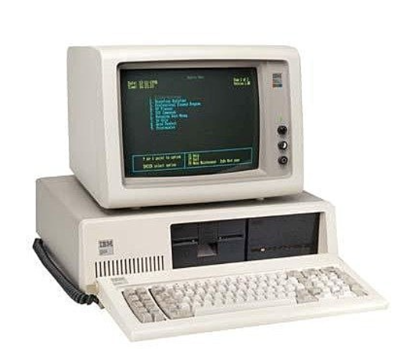
Personal Computers (1980s)
Explosive growth in personal computing with the release of IBM PC (1981) and Apple Macintosh (1984).
Revolutionized computing accessibility and personal productivity.

Slide 8
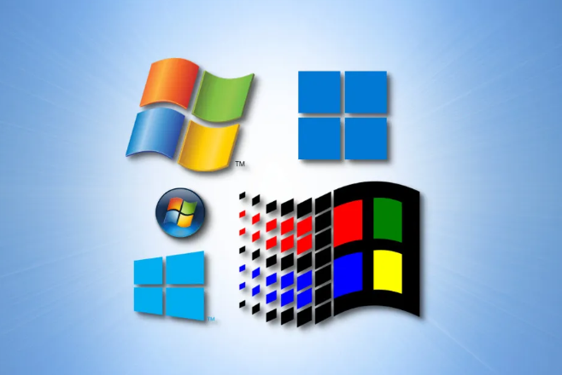
Microsoft Windows (1985)
Microsoft's Windows operating system introduced a graphical interface for MS-DOS, becoming a dominant force in personal computing.

Slide 9

Internet and World Wide Web (1990s)
Widespread adoption of the internet and the development of the World Wide Web revolutionized communication and information sharing

Slide 10
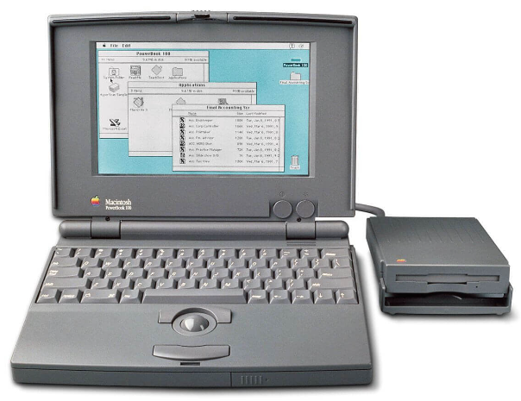
Laptops and Mobile Computing (1990s-2000s)
Laptops, smartphones, and tablets brought computing power on the go, transforming the way people work and communicate
Laptop and mobile computing provide users with portable, on-the-go access to digital resources, enabling work, communication, and entertainment from virtually anywhere with an internet connection."

Slide 11
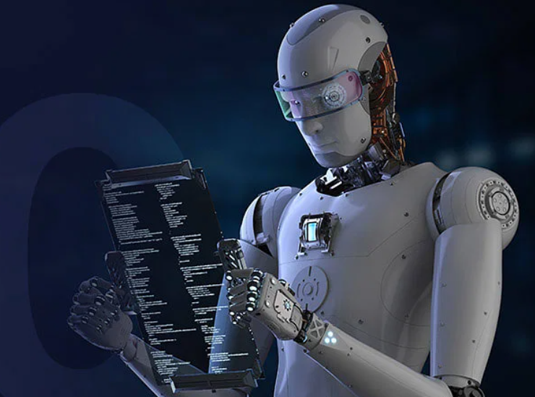
Artificial Intelligence and Machine Learning
Artificial Intelligence (AI) is a branch of computer science that focuses on creating systems capable of performing tasks that typically require human intelligence. This includes learning, reasoning, problem-solving, perception, and language understanding.
A subset of AI, Machine Learning involves training computers to learn from data and make decisions or predictions without being explicitly programmed. It relies on algorithms that enable systems to recognize patterns and improve over time.

